Slide 1
chapter 8
Magnetically
Coupled Circuits

Slide 2
Contents
Introduction to electromagnetism
Mutual Inductance
Magnetically coupled circuits
Energy Analysis

Slide 3
Introduction to Electromagnetism
conductively coupled circuit :one loop affects the neighboring loop through current conduction.
All the circuits we have considered so far may be considered as this
MAGNETIC COUPLED CIRCUITS: when two loops with or without contacts between them affect each other through the magnetic field generated by one of them.
For example :transformer (through mutual inductance).

Slide 4
Faraday’s law of Electromagnetic Induction
Faraday's law states that when there is a change in the magnetic field around a conductor, an electromotive force (EMF) is induced in the conductor, which results in the generation of an electric current. The magnitude of the induced EMF is directly proportional to the rate of change of the magnetic field.
the greater will be the induced voltage across the conductor.
by increasing the speed with which the conductor passes through the field
the stronger the magnetic field strength

Slide 6
Self inductance
Self Inductance can be described as the measure of the opposition of an inductor to the change of current flowing through itself, measured in henrys (H).

Slide 7
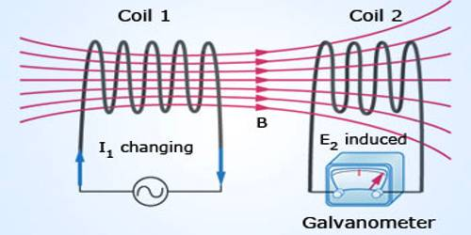
Mutual inductance
When two inductors (or coils) are in a close proximity to each other, the magnetic flux caused by current in one coil links with the other coil, thereby inducing voltage in the latter. This phenomenon is known as mutual inductance.

Slide 8
Mutual Indactance
When two inductors (or coils) are in a close proximity to each other, the magnetic flux caused by current in one coil links with the other coil, thereby inducing v oltage in the latter . This phenomenon is known as mutual inductance
Now consider two coils with self-inductances L1 and L2 that are in close proximity with each other (Fig. 13.2). Coil 1 has N1 turns, while coil 2 has N2 turns. F or the sak e of simplicity , assume that the second inductor carries no current. The magnetic flux ϕ1 emanating from coil 1 has two components: One component ϕ11 links only coil 1, and another component ϕ12 links both coils. Hence,
ϕ1= ϕ11+ ϕ12

Slide 9
Since the entire flux ϕ1 links coil 1, the v oltage induced in coil 1 is
Only flux ϕ12links coil 2, so the voltage induced in coil 2 is
Again, as the fluxes are caused by the current i 1flowing in coil 1, Eqn. can be written as
where L1 = N1 dϕ1∕di1 is the self-inductance of coil 1. Similarly, Eq. can be written as
where M21 is known as the mutual inductanceof coil 2 with respect to coil 1. Subscript 21 indicates that the inductance M21 relates the voltage induced in coil 2 to the current in coil 1. Thus, the open-circuit mutual voltage(or induced voltage) across coil 2 is

Slide 10
ENERGY IN A COUPLED CIRCUIT
The energy stored in an inductor is given by
We now want to determine the energy stored in magnetically coupled coils
the total energy stored in the coils is
If one current enters one dotted terminal while the other current leaves the other dotted terminal.in that case

Slide 11
ENERGY IN A COUPLED CIRCUIT
The energy stored in the circuit cannot be negative .Thus, the mutual inductance cannot be greater than the geometric mean of the self-inductances of the coils.
coefficient of coupling k, given by

